Slide 1

Audio Signal Zoom for Small Microphone Arrays
Chi Hang Leung, Vincent
Supervised by Dr. Patrick Naylor
Notes:
Good afternoon everyone. I am Vincent Leung, and today I am going to present about my project - Audio Signal Zoom for Small Microphone Arrays

Slide 2
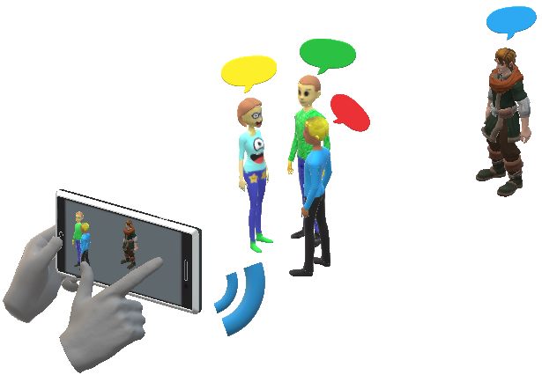
Project Concept
Notes:
Imagine you are at a cocktail party. You wish to capture the precious moment and take a video of your friend using smartphones. However, there are also other group of people talking. In visual terms, you would swipe your phone to try to zoom in to your friend. What if the same happens to the audio?

Slide 3
Background
“Cocktail Party Problem” by Colin Cherry in 1956
Replicate the ability of Human Ears and Brain
Classical Techniques like Beamforming requires Large Microphone Arrays
Notes:
This was the cocktail party problem discovered by Colin Cherry in 1956. While human ears and brains can act as a filter towards the desired sound source, it has been found that the same effect was challenging to be replicated by microphones. Over the years, beamforming has been regarded as one of the most established technique. However, it usually requires large microphone arrays, which motivates the project to enhance the current approaches or explore alternative approaches.

Slide 4
Aims and Objectives
Capture Audio examples containing two speakers in a room under different reverberant conditions
Develop audio zooming algorithms applicable on smartphones
Evaluate algorithms using Subjective and Objective Metrics
Notes:
To achieve this, the project can be decomposed into three main aims. Firstly, audio data containing multiple speakers would be required. In the context of the project, the number of speakers are fixed to be two. The second aim is developing an audio zooming algorithms, while the third aim is to evaluate the algorithm using subjective and objective metrics.

Slide 5
Capturing Audio Samples
Real-life Recording vs. Software Simulation ✔
Flexibility of modifying parameters easily
Modelling the Room as a Linear Time-invariant (LTI) System
Generate Room Impulse Response
Anechoic Speech from IEEE Sentences
→ Convolution
Notes:
So how can we capture the audio examples. A straightforward option would be organizing a recording session.
Method of Images by Allen and Berkeley

Slide 6
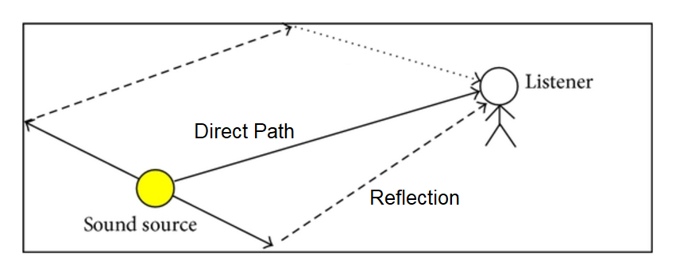
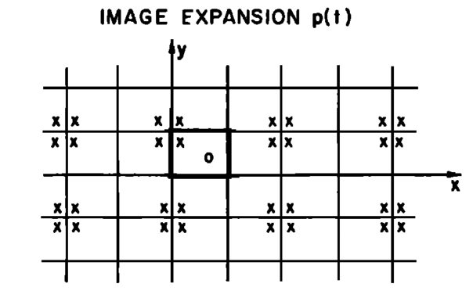
Room Acoustics
Reverberation - Persistence of Sound after its production
RT₆₀ – Time taken for Reverberant energy to decay by 60 dB
320 ms for Office Room, 1.7s for Level 2 Lobby in EEE building
Method of Images
Notes:
Before going into discussion about the capturing the audio samples, it is important to know how sound changes based on different rooms and how it affects the received sound. Reverberation is persistence of Sound after its production. It is mainly due to the reflection from the walls in a room. Hence, reverberation would decay slower in a larger room. This can be quantified using RT60, the reverberation time. It is the time taken for Reverberant energy to decay by 60 dB.

Slide 7
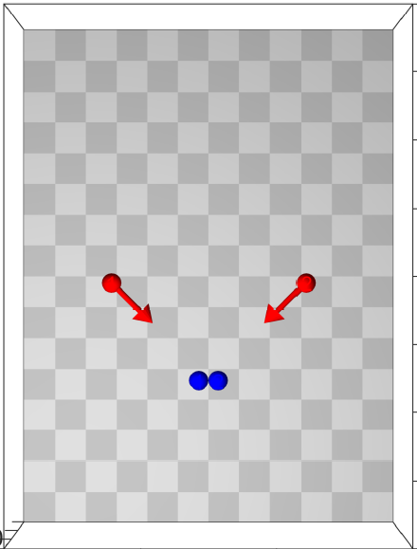
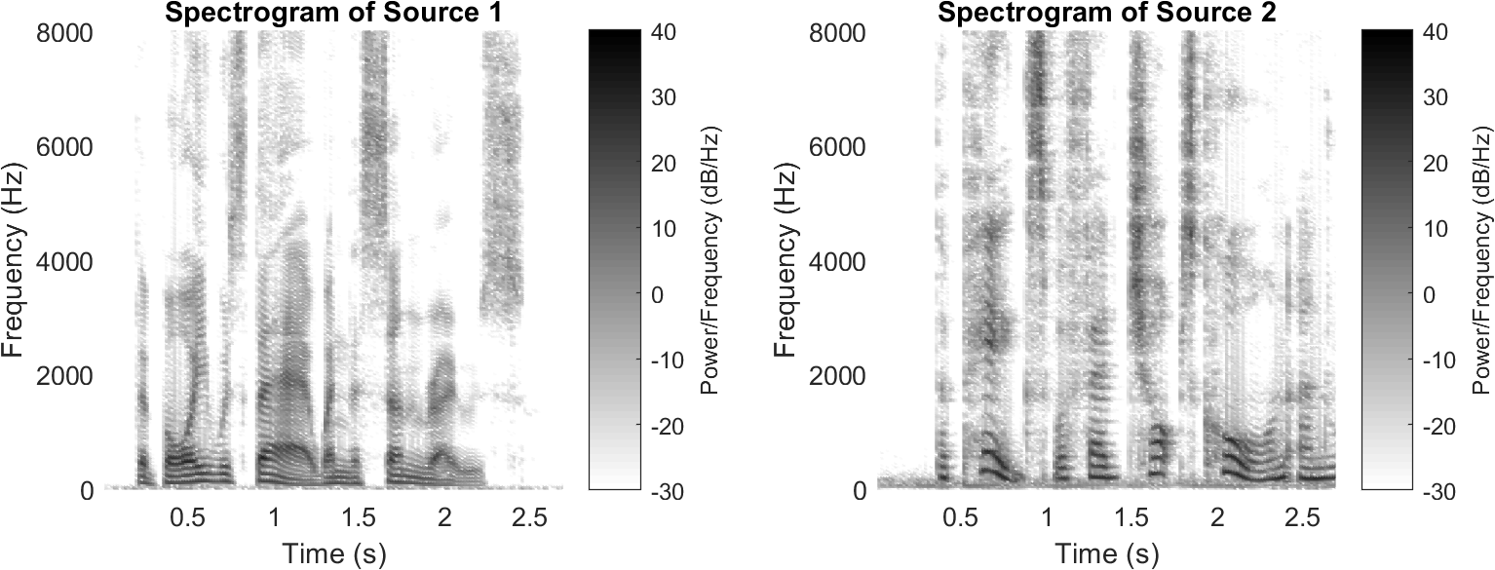

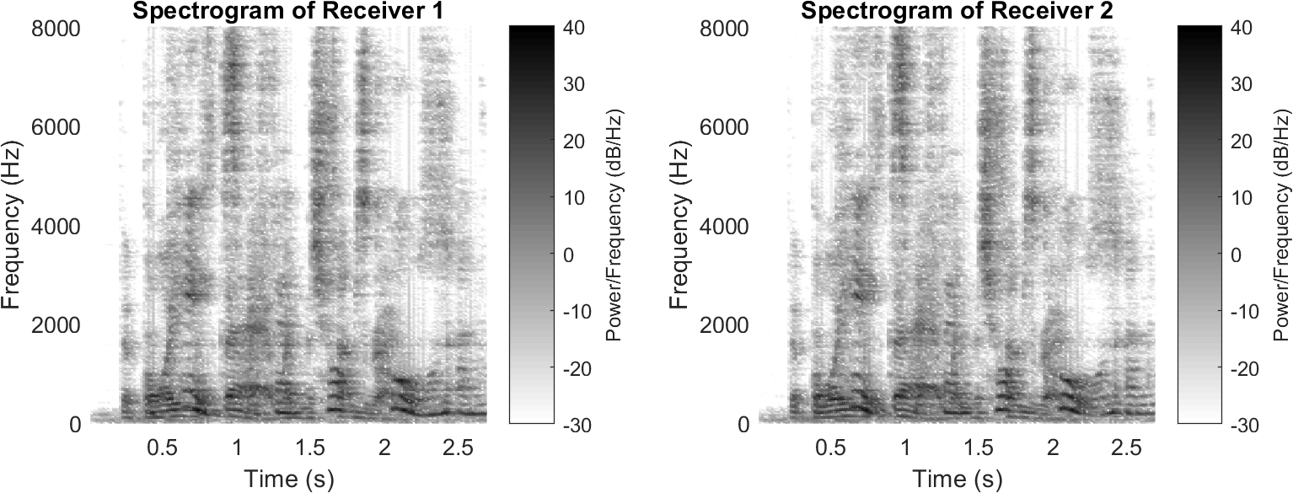
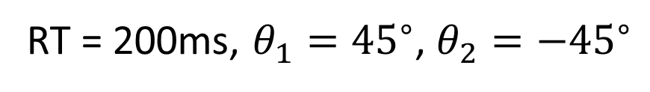
RT = 200ms, $θ_{1}={45}^{∘}$, $θ_{2}=−{45}^{∘}$
Notes:
In this presentation, we would be focusing on this case.

Slide 8
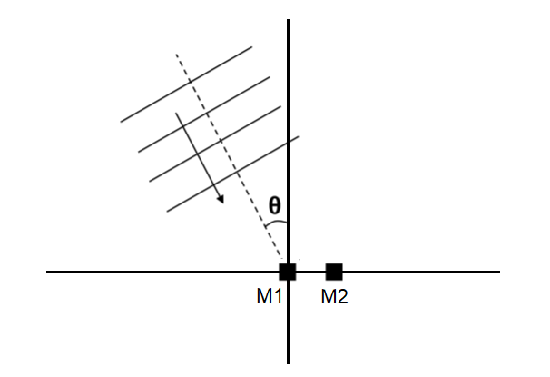
Algorithmic Development
Rationale:
Only Information: Direction of Arrival (DOA) of the Desired Speaker
Notes:
The next step was to develop the audio zooming algorithm. One key principle to be followed in the project is that the only information possessed was the direction of arrival of the desired speaker. We have no information about any characteristics of interference and noises.

Slide 9
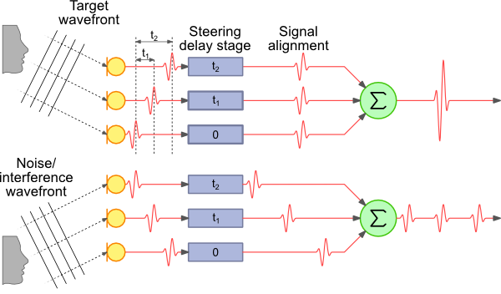
Beamforming
Delay-Sum Beamformer (DSB)

Slide 10
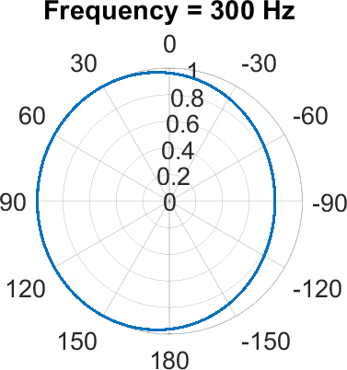
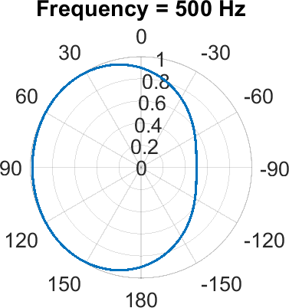
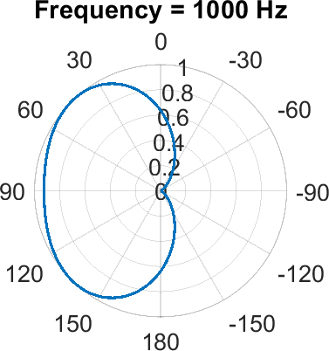
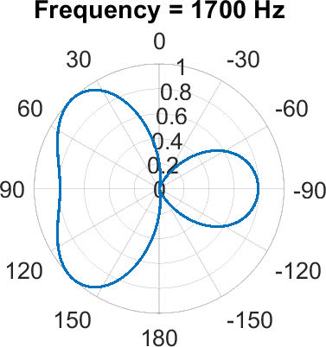
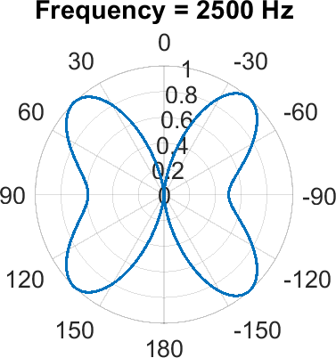
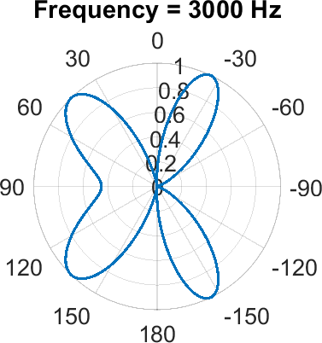
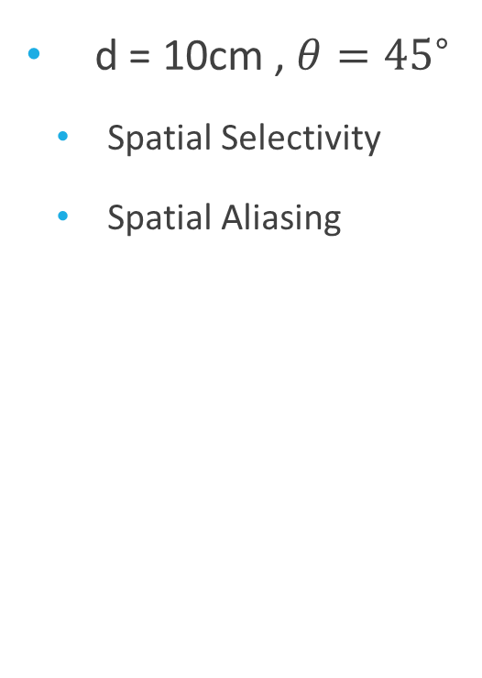
DSB Array Pattern
d = 10cm , $θ={45}^{∘}$
Spatial Selectivity
Spatial Aliasing
Notes:
Here shows the result of a delay-sum beamformer using a microphone separation of 10cm. The array pattern is plotted from 300Hz to 3000Hz, which represents the voice band. At low frequencies, observing the beam patterns, it possesses a very low spatial selectivity.
Spatial Aliasing is also another problem. When the separation of the microphone is larger than half wavelength, extra beams would appear.
Might be useful as an enhancement method.

Slide 11
Time-Frequency Mask
W-disjoint Orthogonality (W-DO) Assumption:
Each Time-Frequency (TF) bin is only occupied by a single source
Existence of a Perfect Binary Mask
Speech are approximately W-DO
80% of source power remains when one source dominates another by 15 dB at a particular TF bin
Notes:
The alternative approach explored in the project was Time-Frequency Mask. This was motivated by the fact that

Slide 12
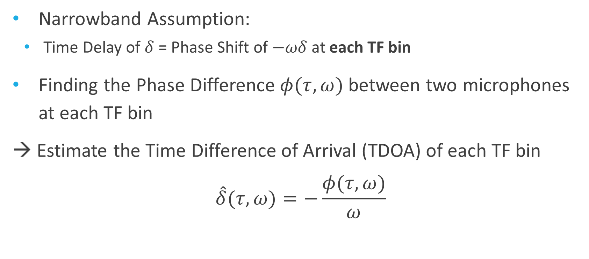
TF Mask Estimation
Narrowband Assumption:
Time Delay of $δ$ = Phase Shift of $−ωδ$ at each TF bin
Finding the Phase Difference $φ(τ,ω)$between two microphones at each TF bin
→ Estimate the Time Difference of Arrival (TDOA) of each TF bin
$$\hat{δ}(τ,ω)=−\frac{φ(τ,ω)}{ω}$$
Notes:
How to “guess” the binary mask.

Slide 13
K-means Clustering
Iterative process to minimize the total within-cluster Euclidean distances
Each TF point was assigned to one cluster
A cluster corresponds to a speaker

Slide 14
Fuzzy c-means Clustering
Approximately W-DO
Each TF bin has chance to be occupied by more than one source
Each TF point now assigned a membership value to each cluster, indicating how likely it is to be in this cluster

Slide 15
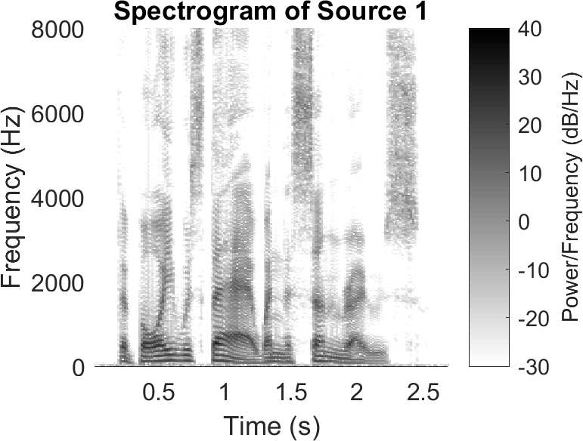
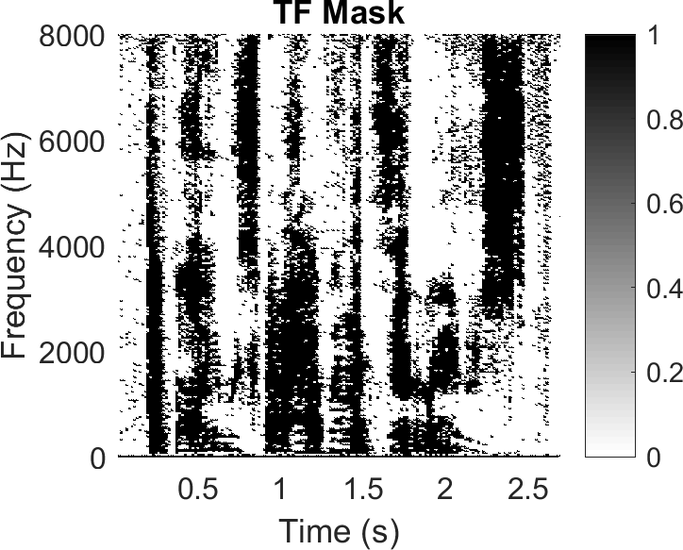
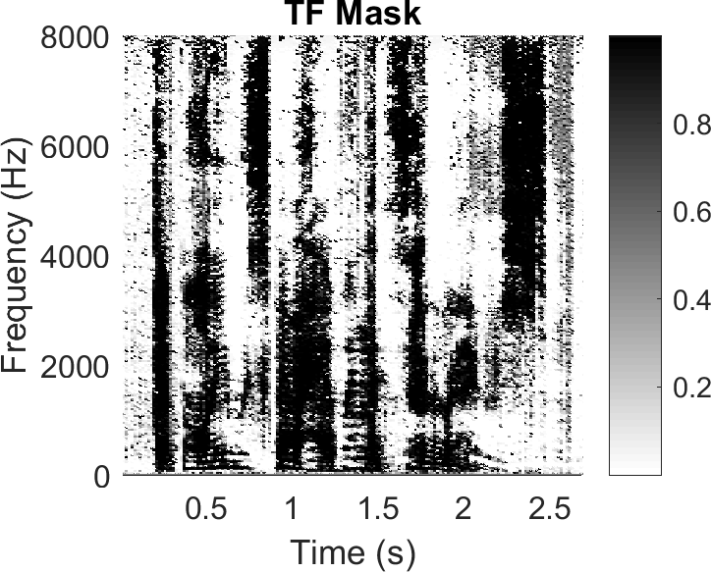
Comparison (Anechoic)
Original Source | K-means Clustering | Fuzzy c-means Clustering

Slide 16
Weighted FCM
Delay estimate at each TF bin is erratic due to reverberation and noise
Confidence Level at each TF bin for Clustering
Variance
Signal-to-Noise Ratio (SNR)

Slide 17
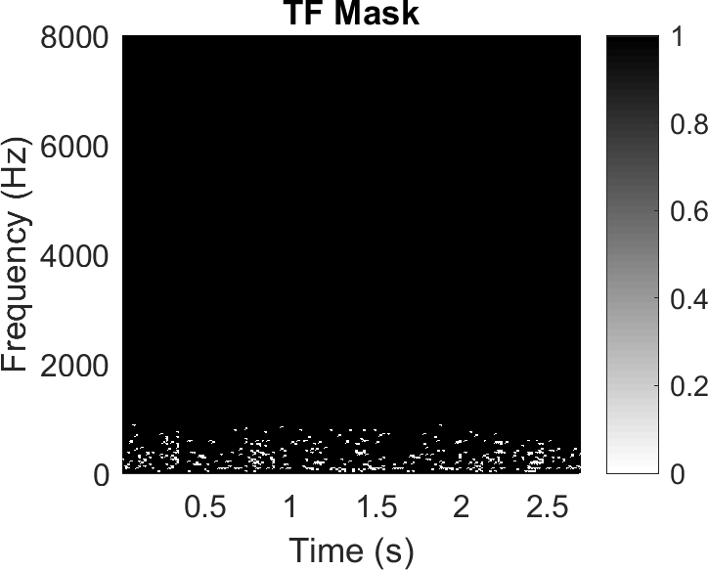
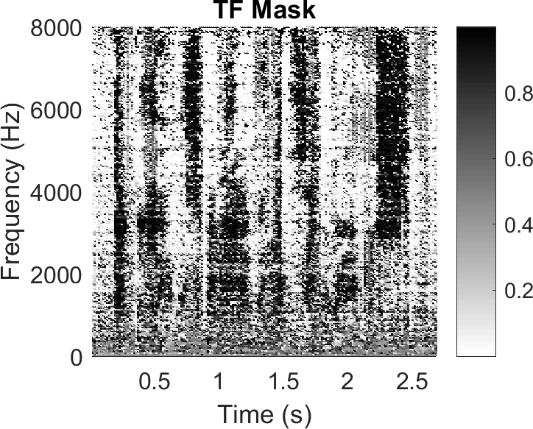
Comparison (RT = 200ms)
FCM | Weighted FCM (Variance) | Weighted FCM (SNR)

Slide 18
Evaluation
Speech Intelligibility
“How many words could you hear?”
Speech Quality
“Did you like the speech?”
Notes:
The evaluation of the algorithms consists of two criteria: speech intelligibility and speech quality. Speech Intelligibility refers to how many words could you hear from the speech, while speech quality refers to did to like the speech. A direct measurement would be conducting a listening test. However, within the time constraint of the project, it was not feasible to produce a statistically significant outcome. Hence, they were estimated using objective metrics that is highly correlated to the actual results.

Slide 19
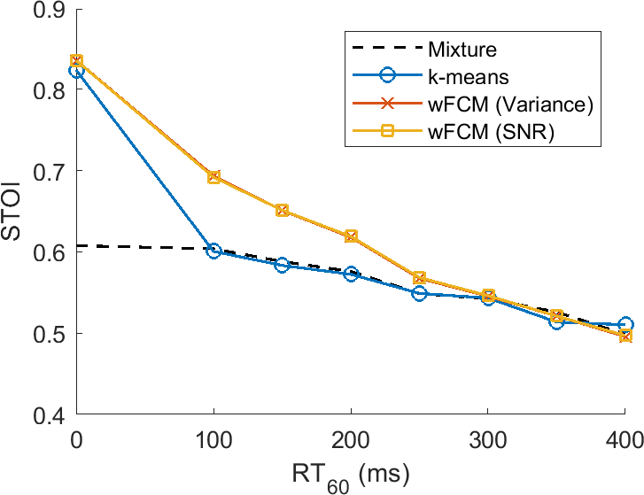
Speech Intelligibility
Short-time Objective Intelligibility (STOI)
Scaled from 0 to 1
1 = 100% of words can be detected accurately

Slide 20
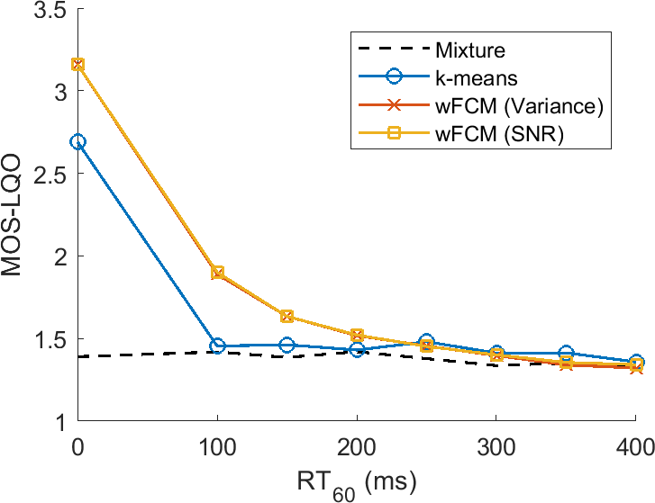
Speech Quality
Mean Opinion Score - Listening Quality Objective
Rating | Label
5 | Excellent
4 | Good
3 | Fair
2 | Poor
1 | Bad

Slide 21
Conclusion
Successfully built a Simulation Platform for generating audio mixtures
Developed Time-Frequency Mask Estimation through Clustering TDOAs
Good performance in anechoic conditions
Huge room for improvement in reverberant conditions

Slide 22
Future Works
Apply to Real-life Scenarios
Real-life recordings
Multi-speaker environment
Develop alternative algorithms
Combination of TF Mask and Beamforming
Machine Learning Approach
Conduct Listening Test
e.g. web-based listening test

Slide 23
Thank you!

Slide 24
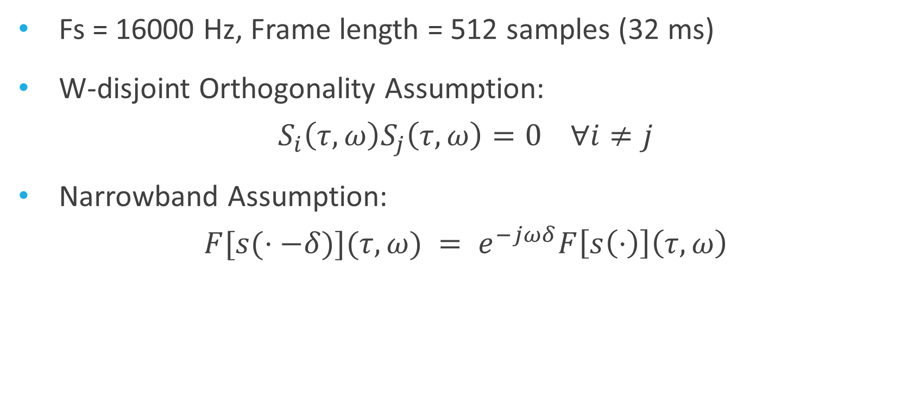
Time-Frequency Mask
Fs = 16000 Hz, Frame length = 512 samples (32 ms)
W-disjoint Orthogonality Assumption:
$$S_{i}\left(τ,ω\right)S_{j}\left(τ,ω\right)=0 ∀i≠j$$
Narrowband Assumption:
$$F[s(⋅−δ)](τ,ω) = e^{−jωδ}F\left[s\left(⋅\right)\right]\left(τ,ω\right)$$

Slide 25
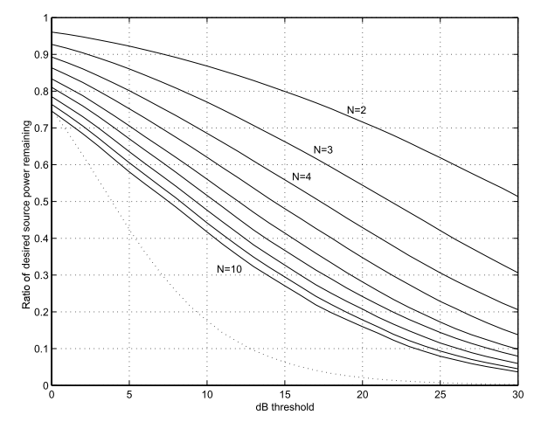
Approximate W-DO

Slide 26
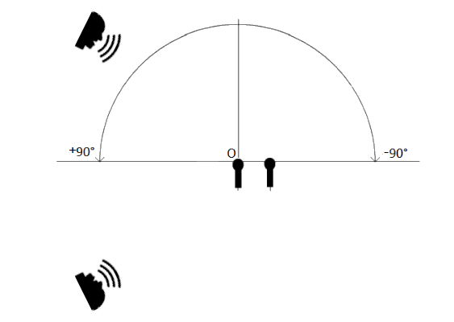

Slide 27
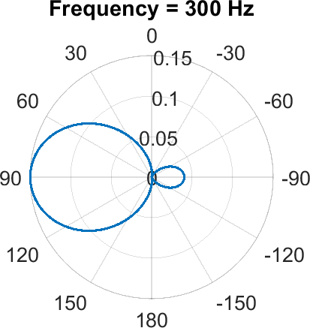
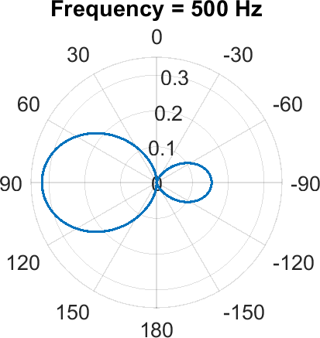
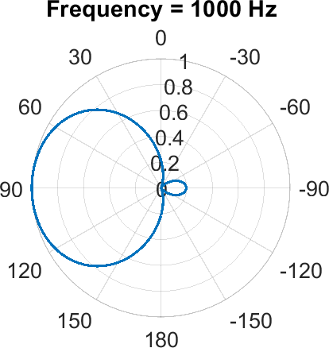
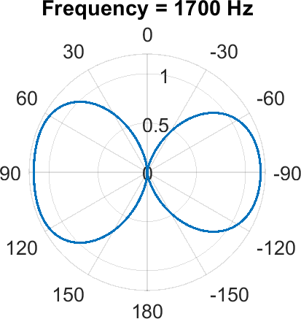
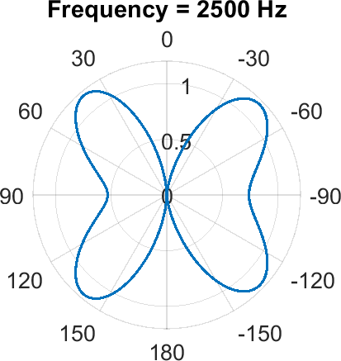
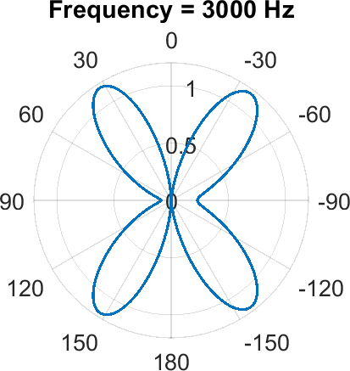
Beamforming
Minimum Variance Distortionless Response (MVDR) Beamformer
Minimizes the output power while preserving power from certain DOA

Slide 28
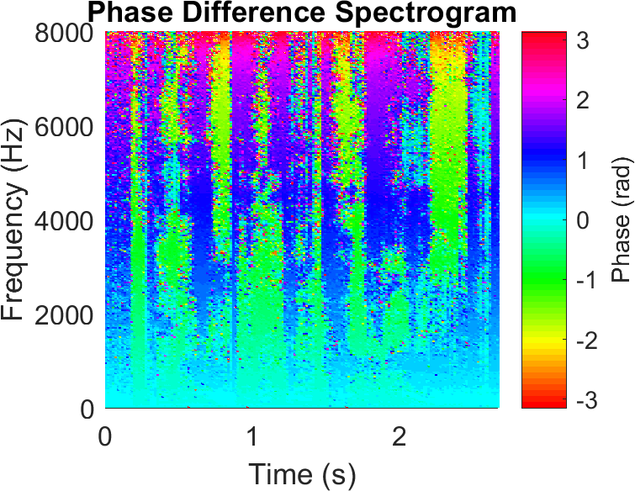
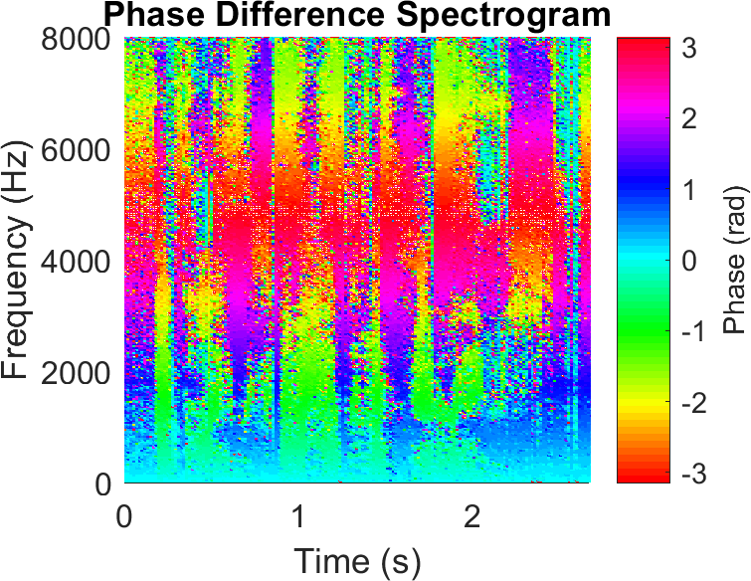
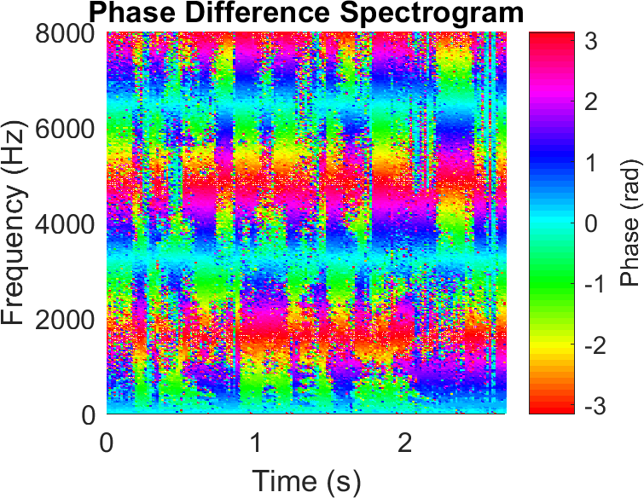
Phase Difference Spectrogram
d = 2cm
d = 5cm
d = 15cm

Slide 29
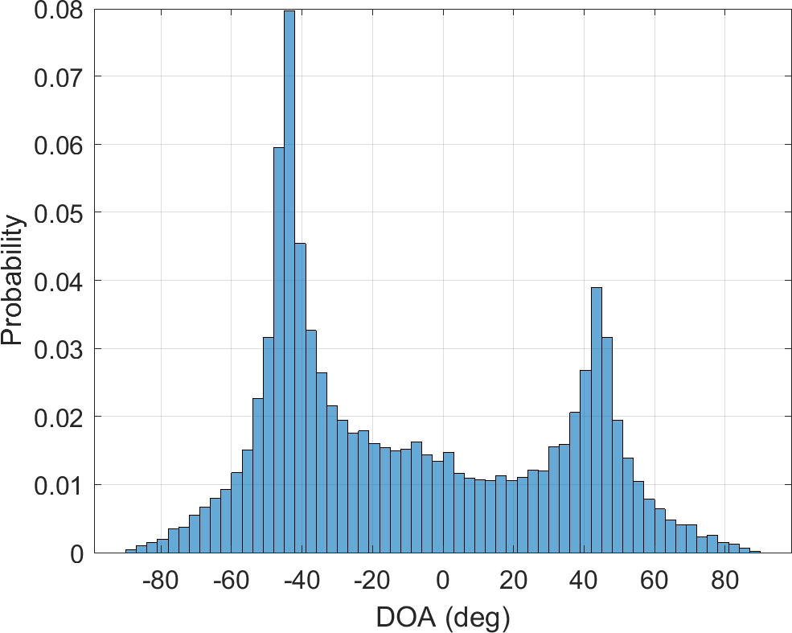
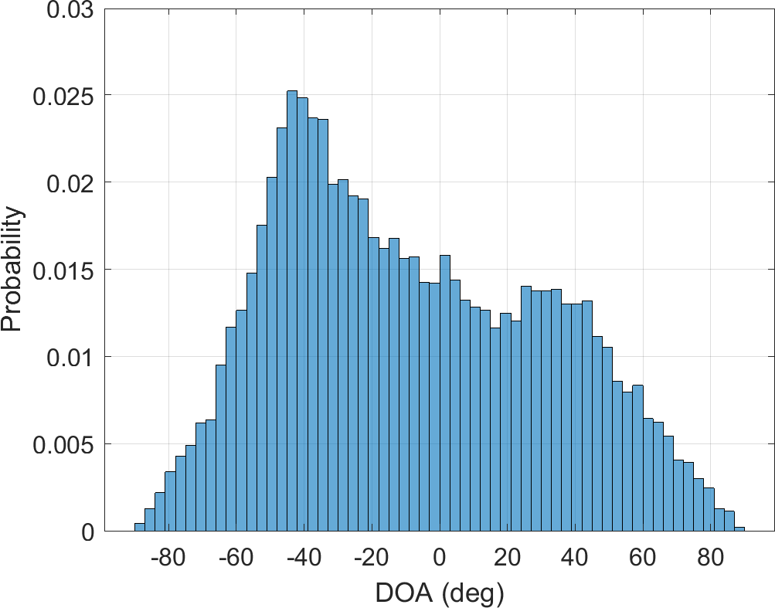
DOA Histogram

Slide 30
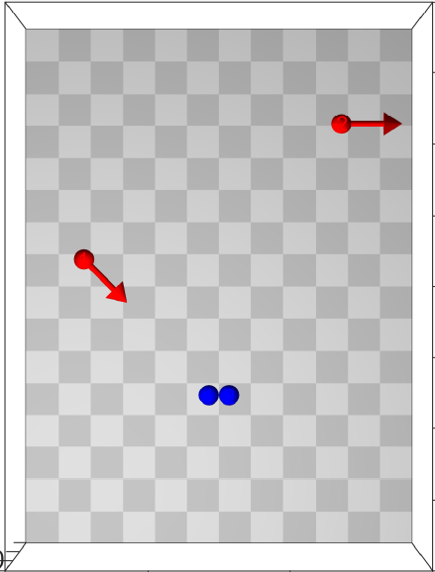
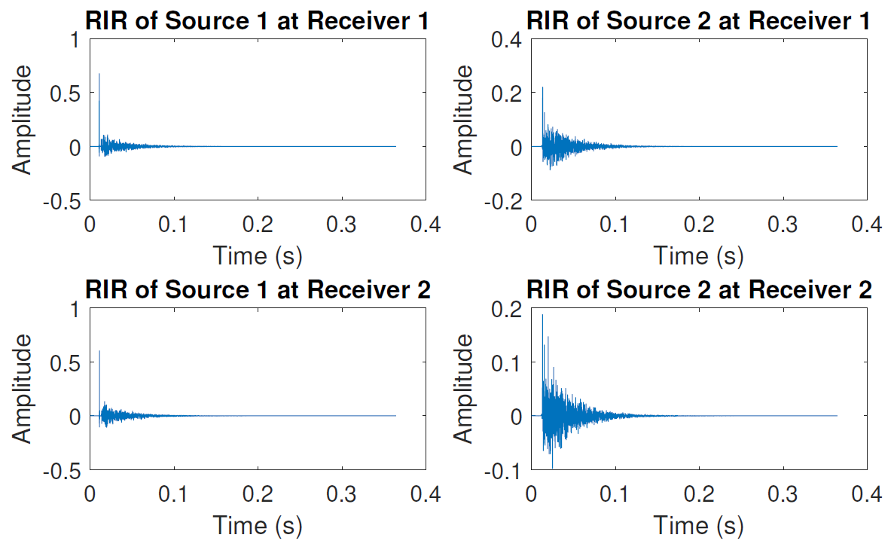
Room Impulse Responses

Slide 31

Machine Learning
Phase Differences → “Weak” feature under reverberation
Deep Neural Networks → Feature Learning

Slide 32
Machine Learning
Proposed Framework:

Slide 33
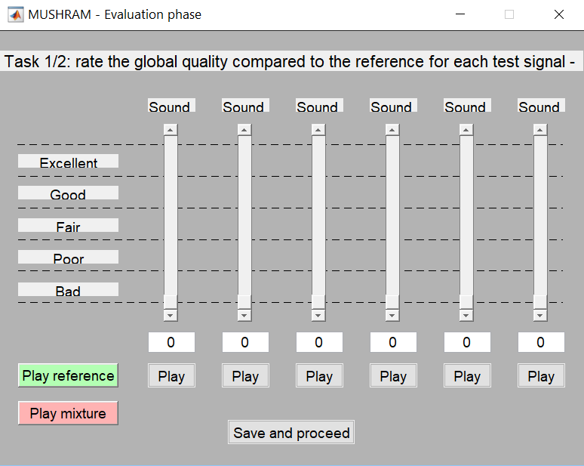
Speech Quality
Multiple Stimuli with Hidden Reference and Anchor (MUSHRA)
Hidden Reference = Perfectly Zoomed Speech
Hidden Anchor = Mixture without any processing

Slide 34
Speech Quality
Conducted informally with 3 participants
“Rate the global quality compared to the reference for each test signal”
“Rate the closeness of the sound”
Results:
Supported the objective measures
Audio Zooming ⇔ Source Separation?
https://chl214.github.io/webMUSHRA/

